Slide 1
Daniel P Griffith RPh BCNSP
Clinical Coordinator Nutrition and Metabolic Support Service
Clinical Study Coordinator
EmoryHealthcare

Slide 2
Acute Physiology And Chronic Health Evaluation ( APACHE II)
Based upon initial values of 12 routine physiologic measurements , age, and previous health status to provide a general measure of severity of disease
An increasing score (range 0 to 71) was closely correlated with the subsequent risk of hospital death for 5815 intensive care admissions from 13 hospitals.

Slide 3
Acute Physiology And Chronic Health Evaluation ( APACHE II)
When APACHE II scores are combined with an accurate description of disease, they can prognostically stratify acutely ill patients and assist investigators comparing the success of new or differing forms of therapy.
At the time of initial screening for this study the score could range from (0-69)

Slide 4
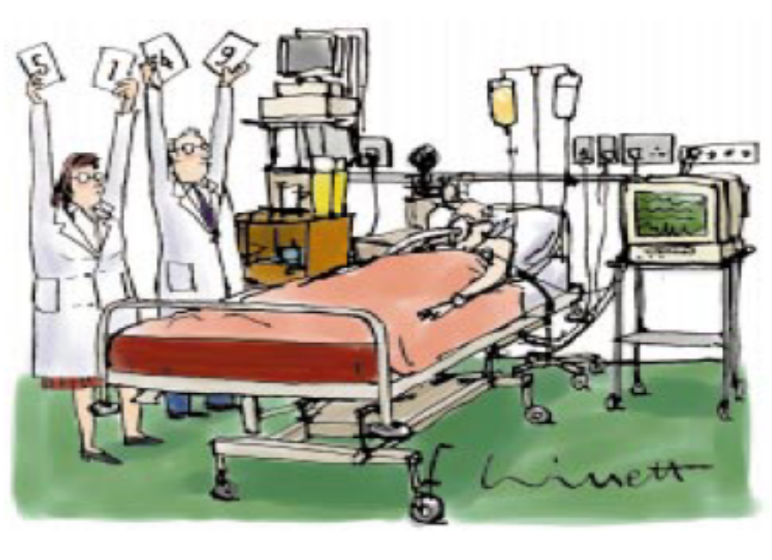

Slide 5
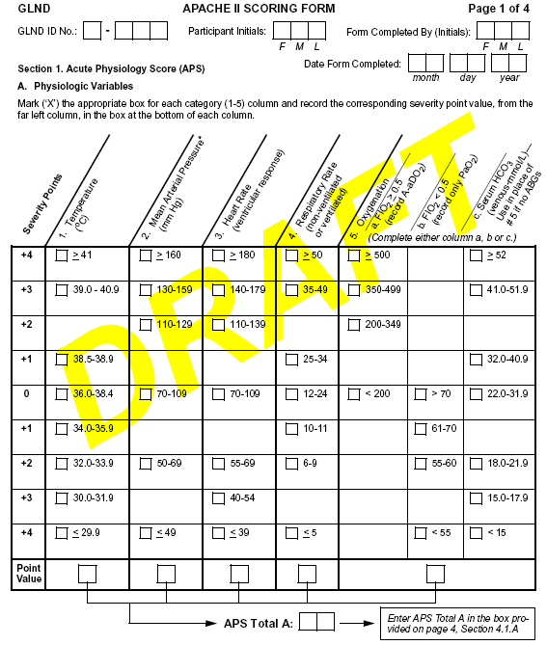

Slide 6
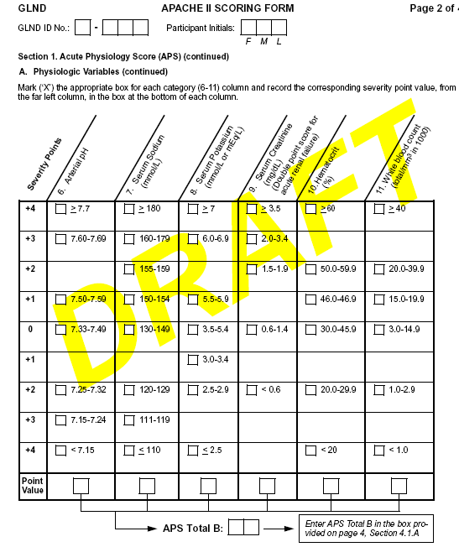

Slide 7
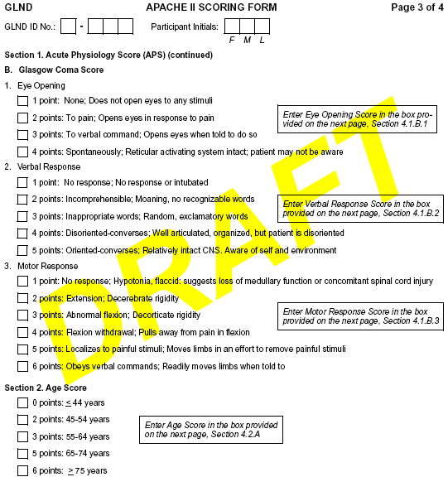

Slide 9
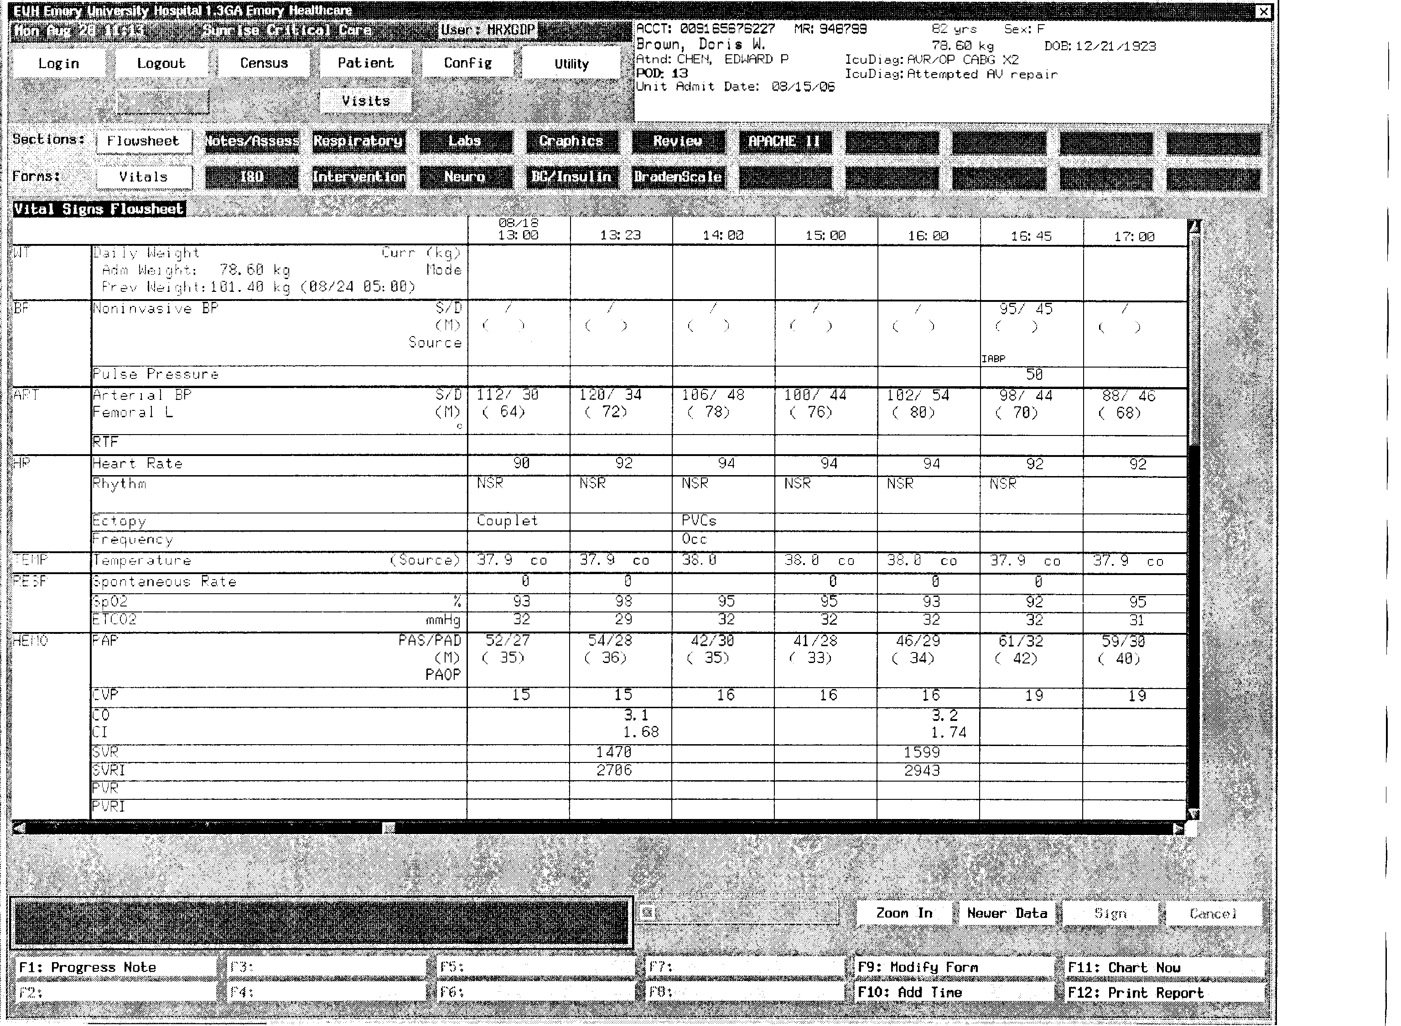

Slide 10
0

Slide 12
0
2

Slide 14
0
2
0

Slide 16
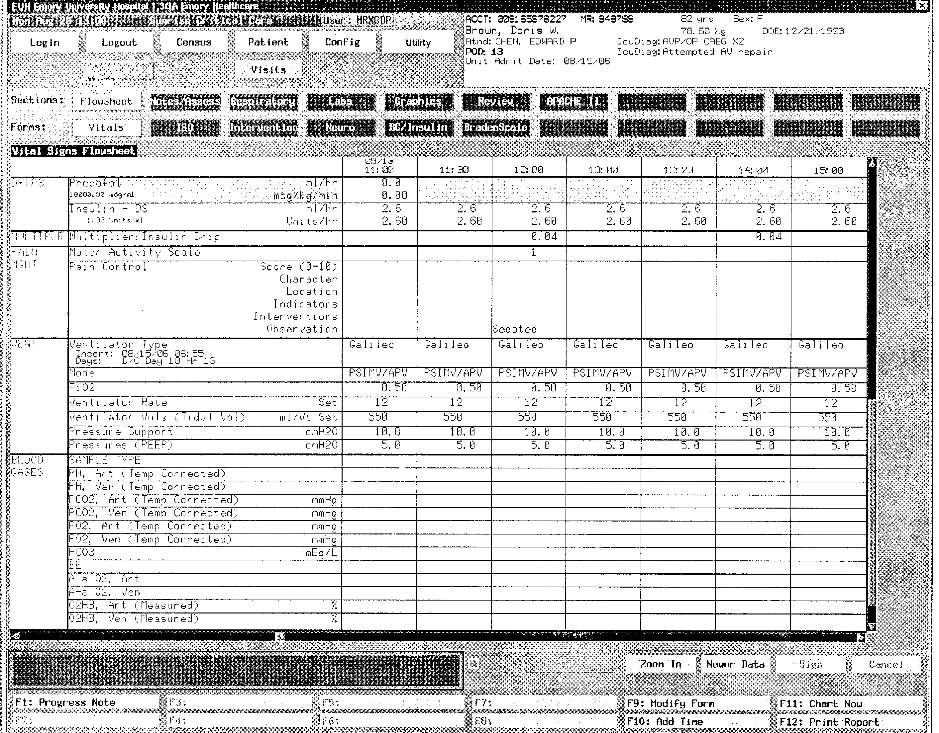

Slide 17
0
2
0
0

Slide 18
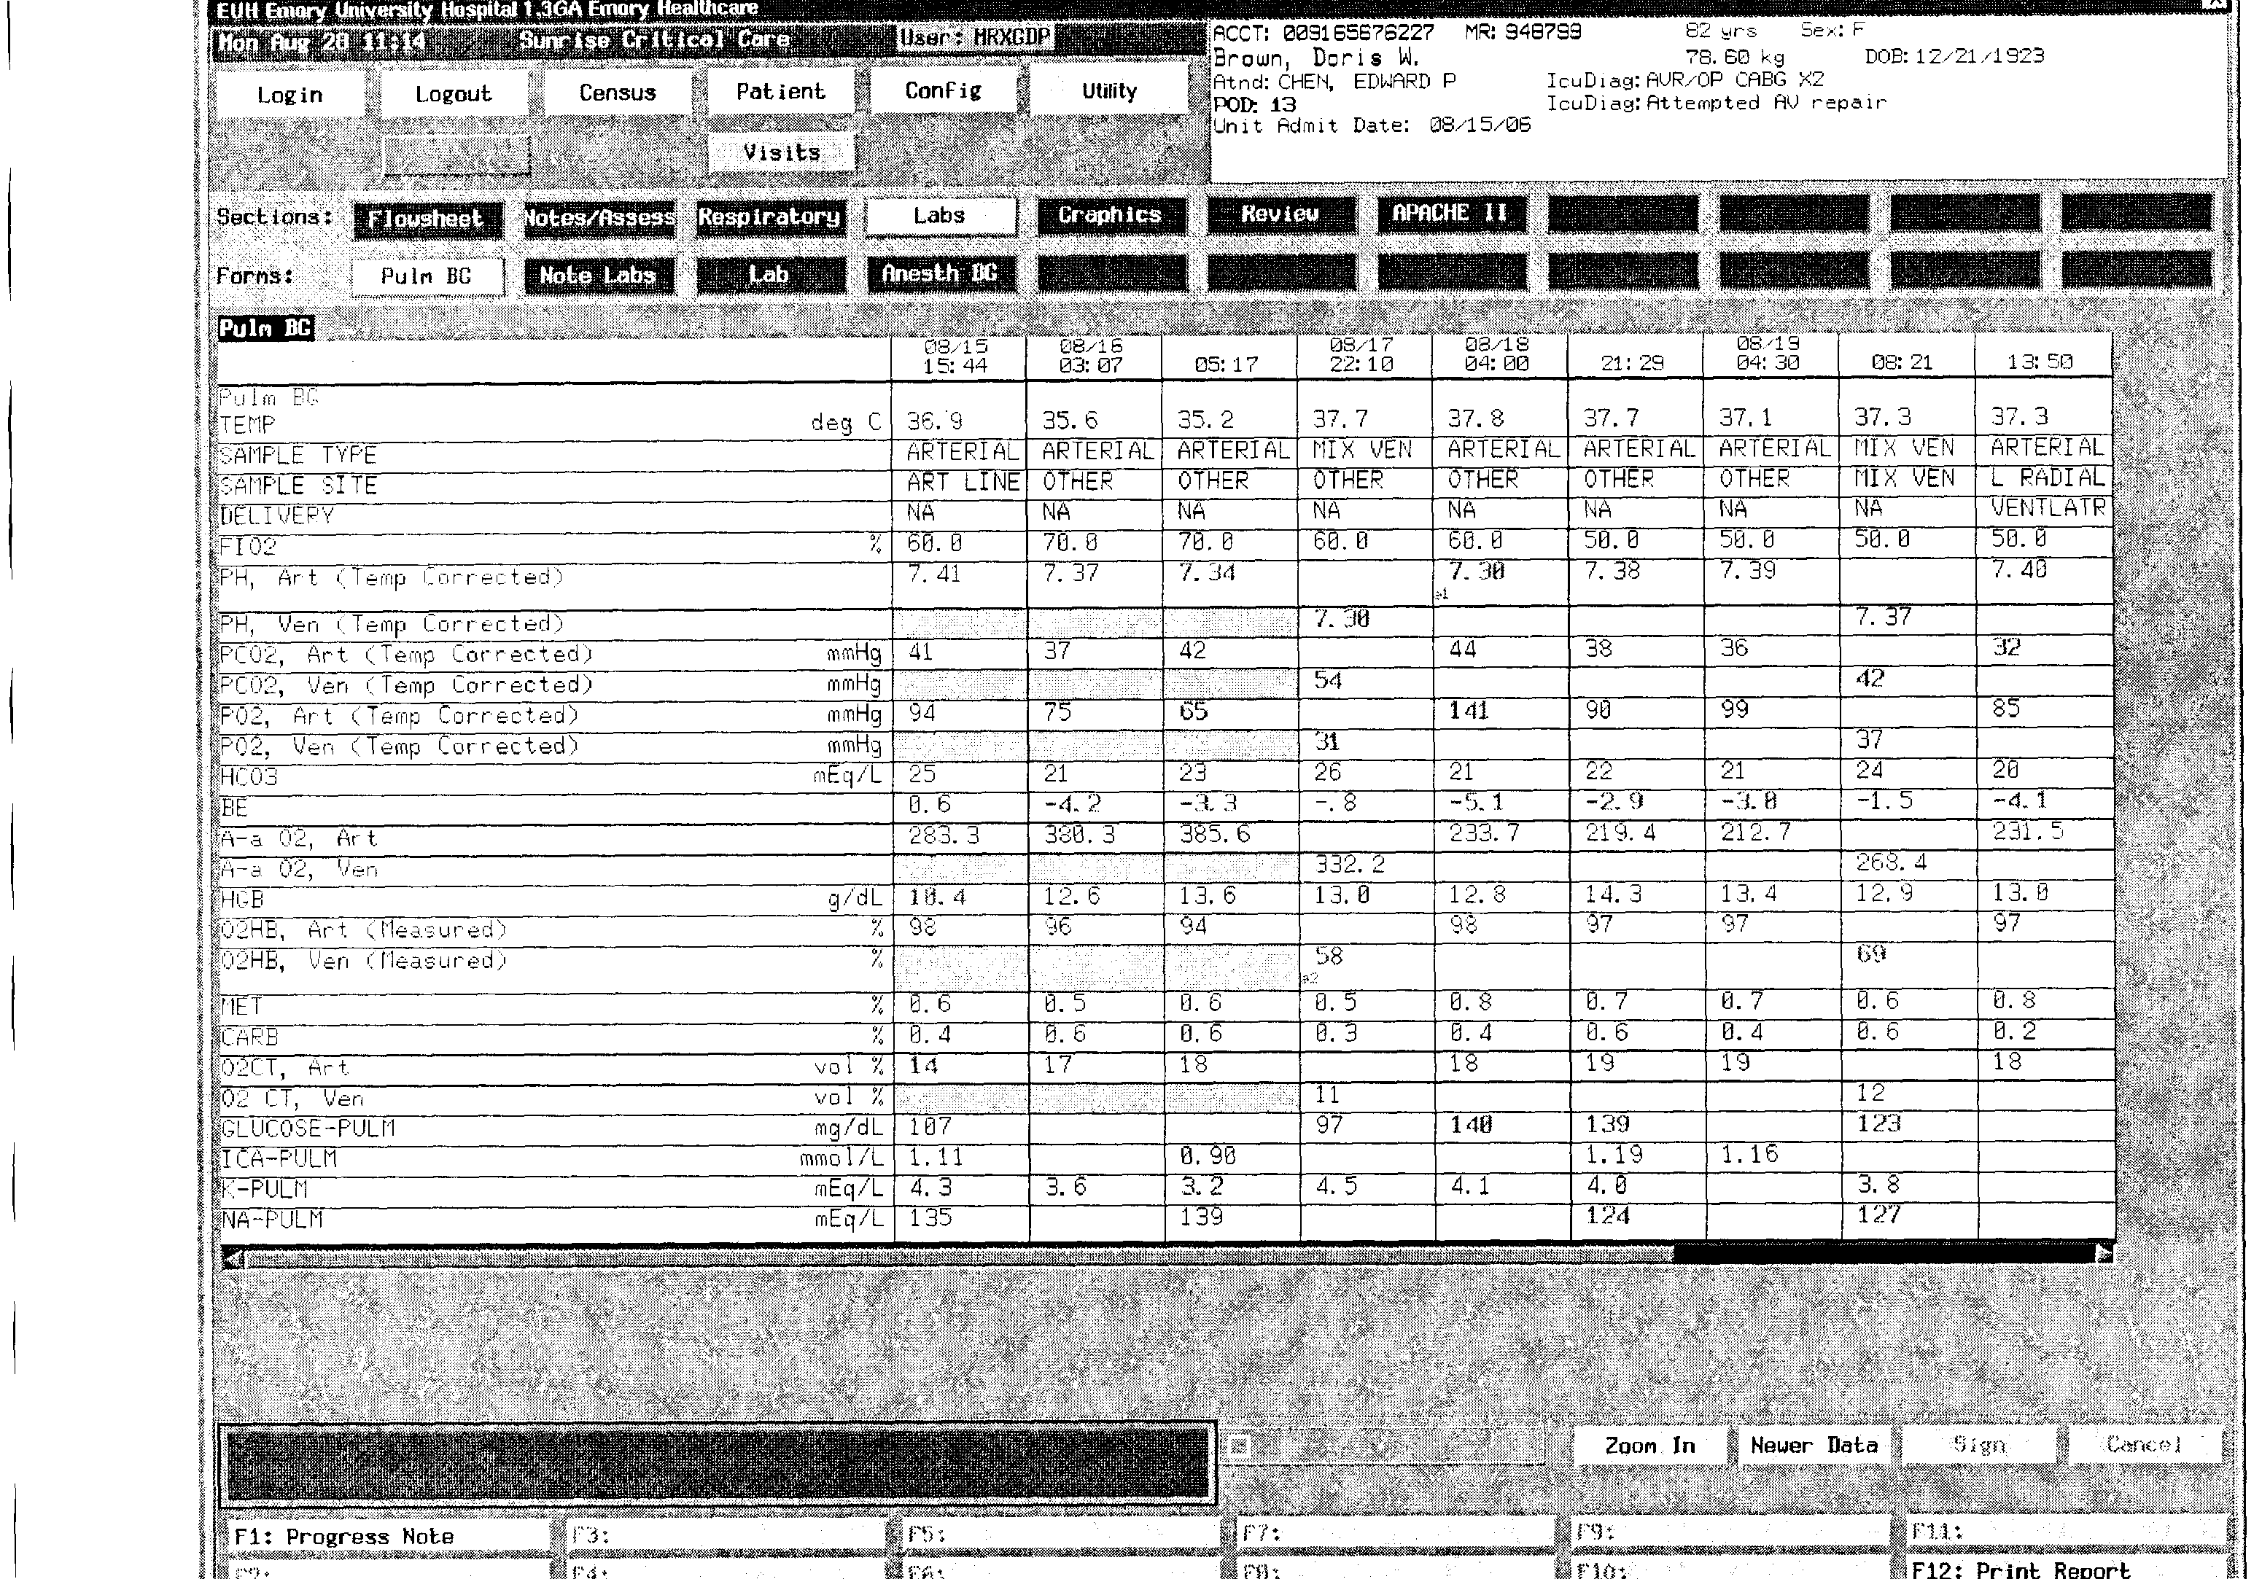

Slide 19
0
2
0
4
2

Slide 22
2

Slide 23
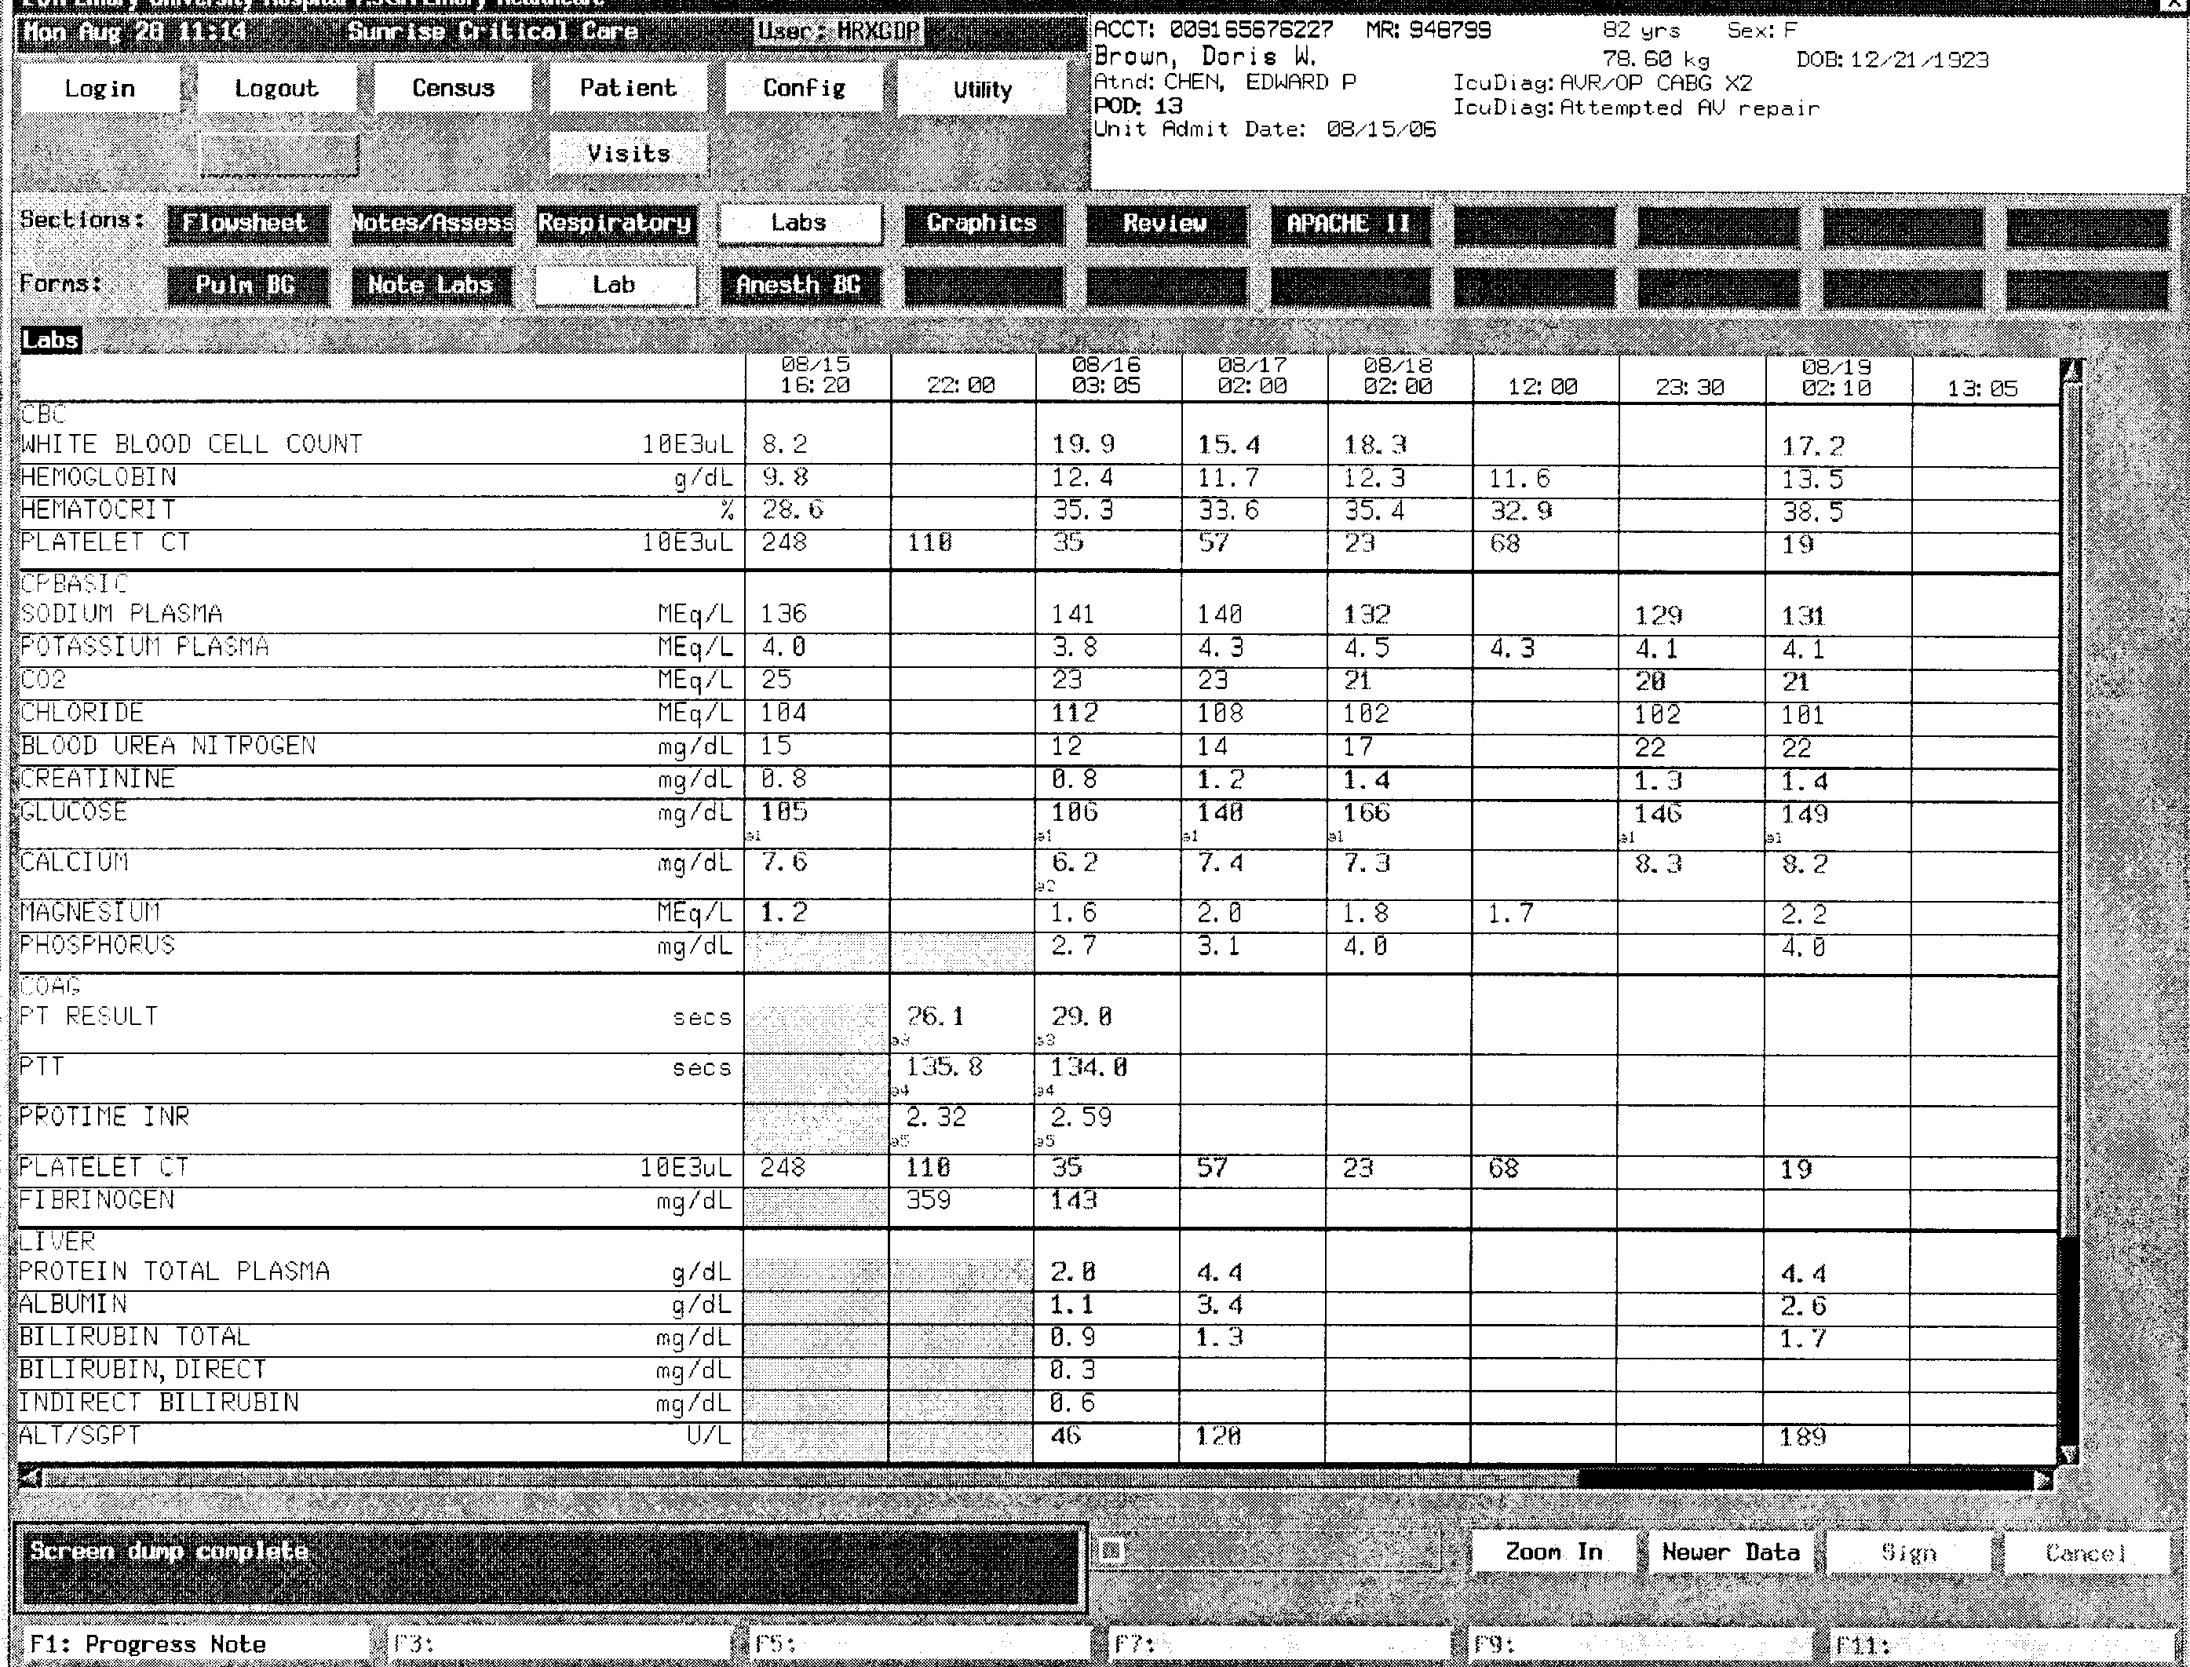

Slide 24
2
0

Slide 26
2
0
0

Slide 28
2
0
0
0

Slide 30
2
0
0
0
0

Slide 32
2
0
0
0
0
1

Slide 34
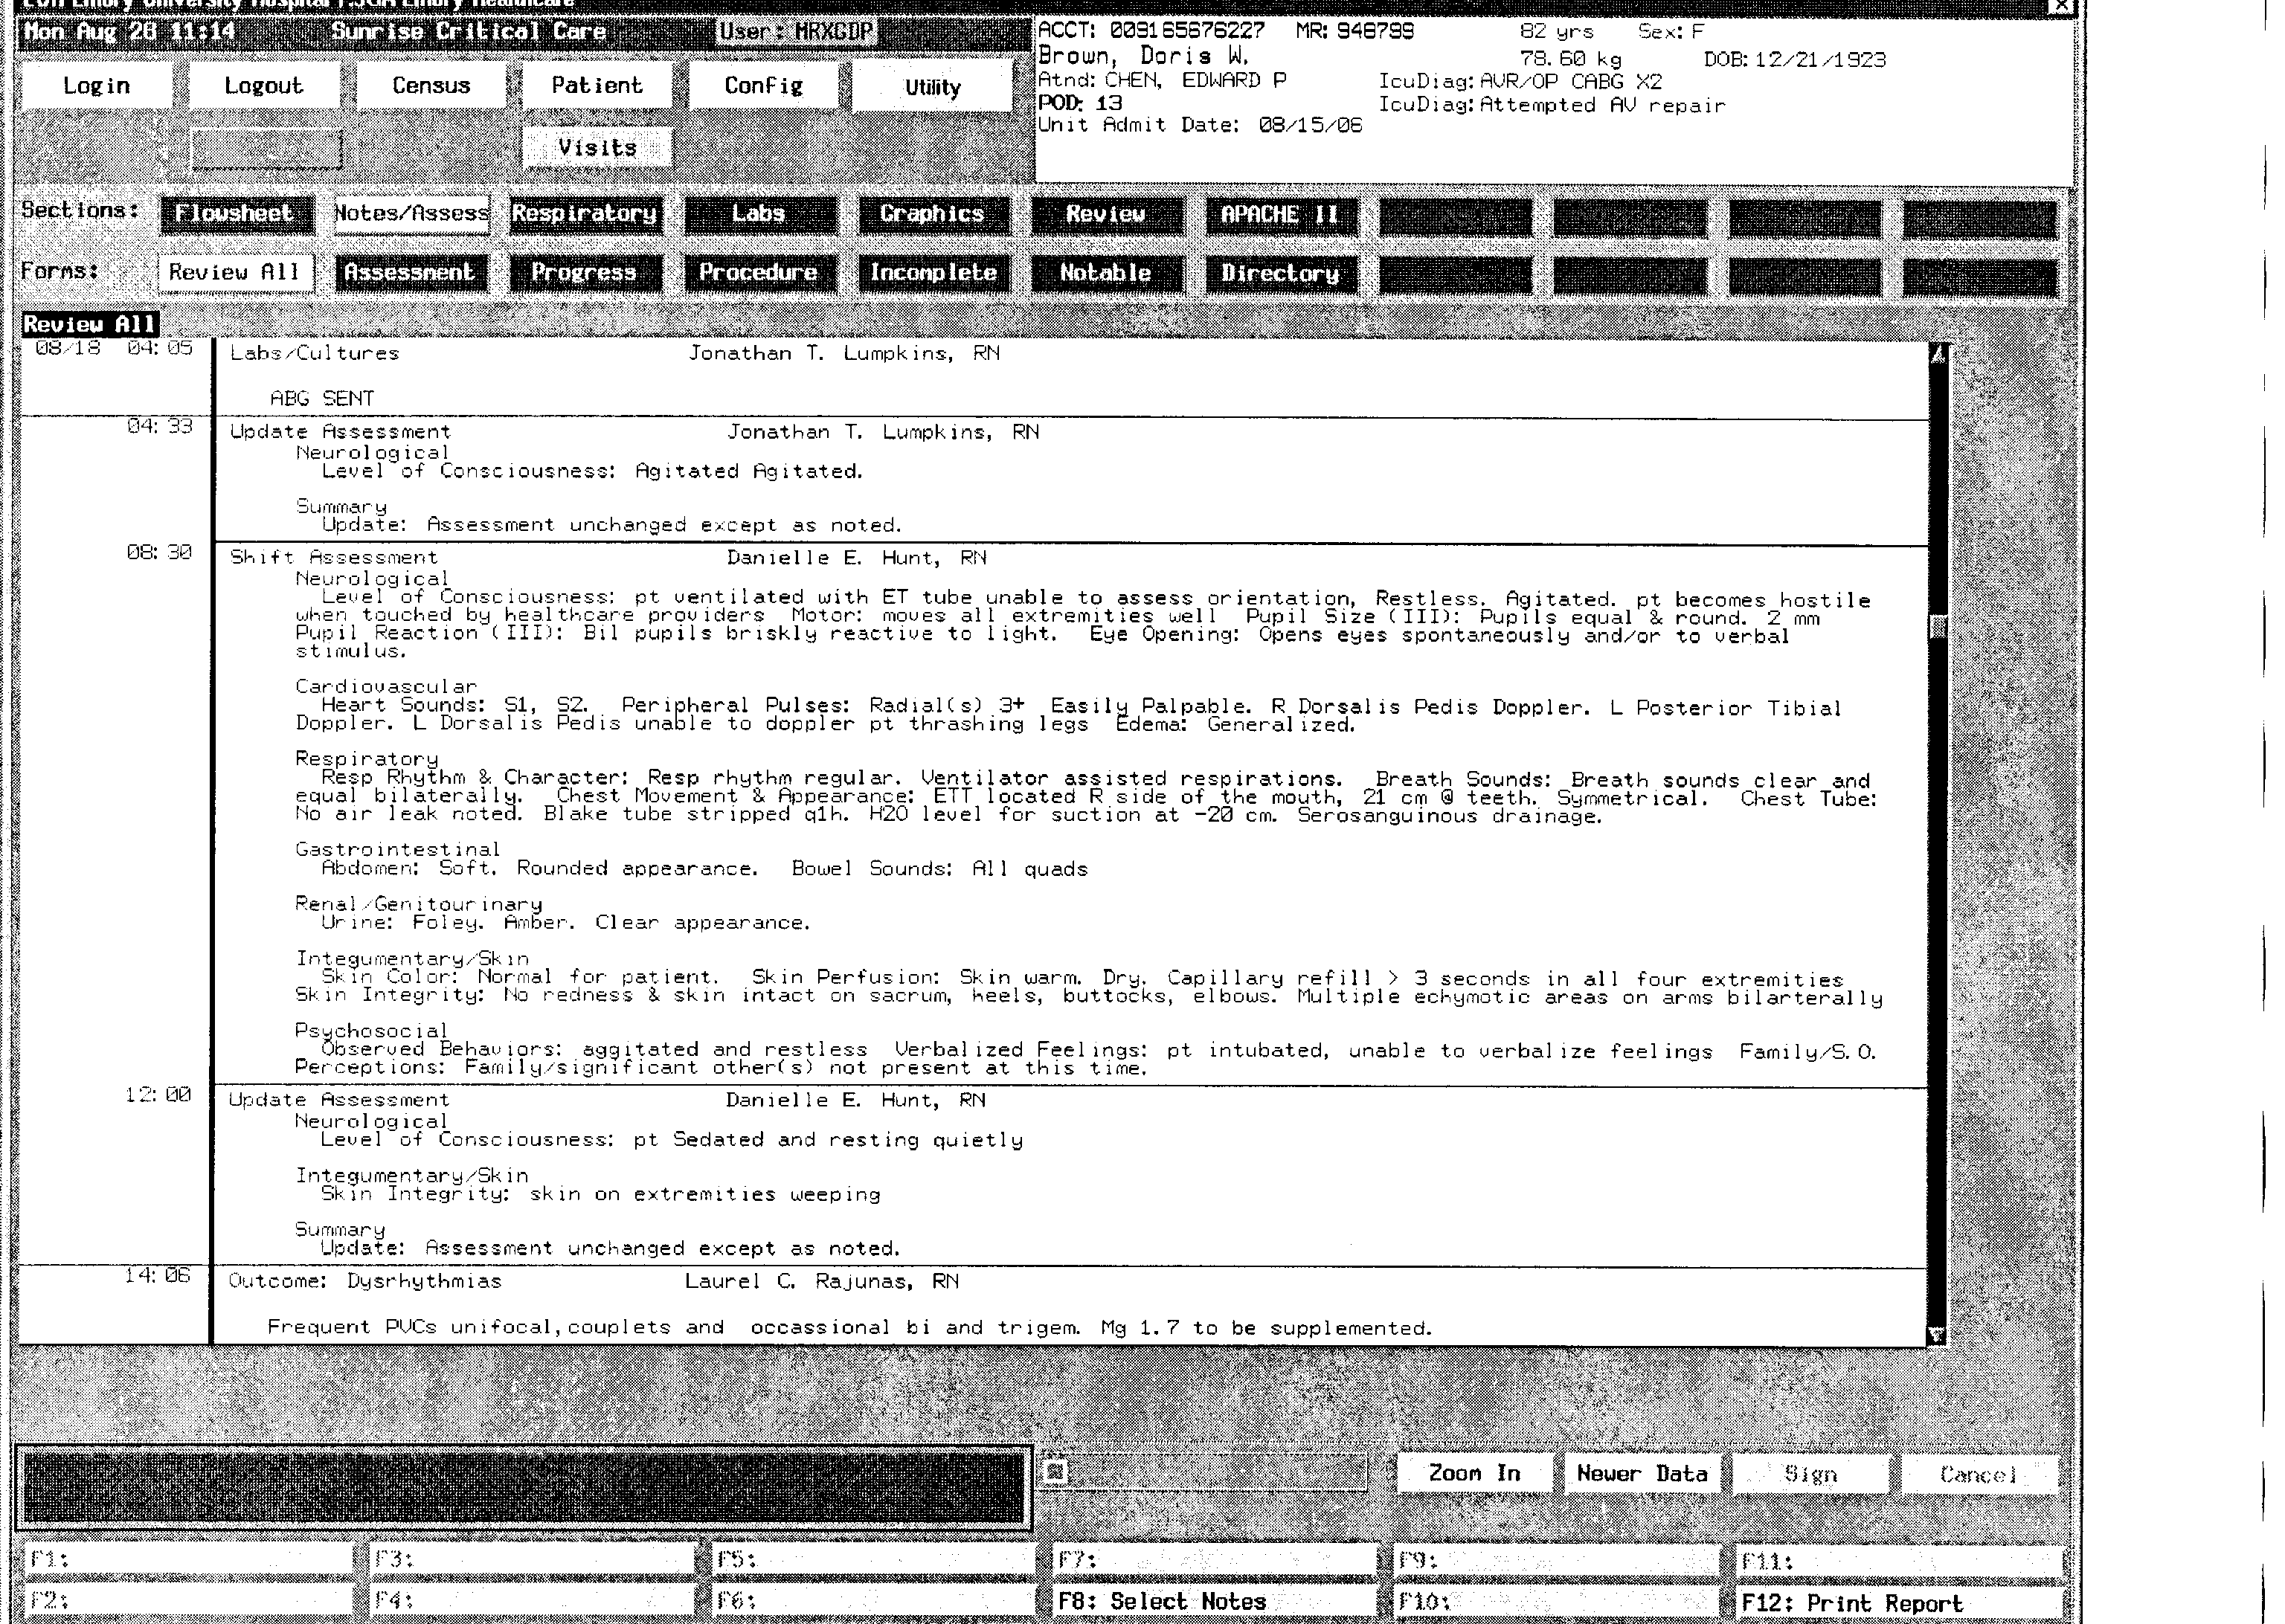

Slide 36
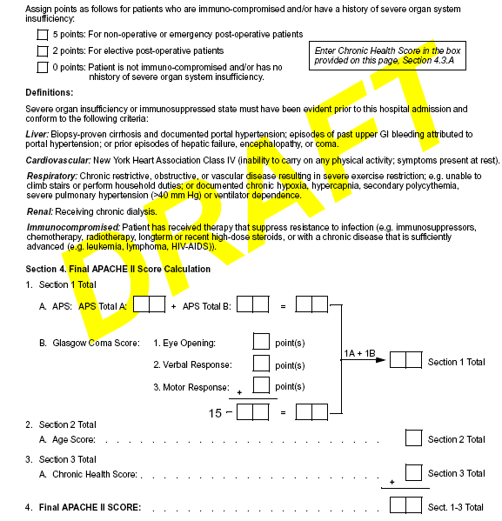
8
3
1 1
3
1
1 6
6
1 0
5
6
2
2 4

